Slide 1


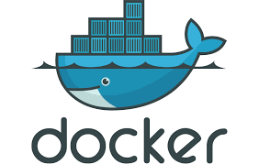

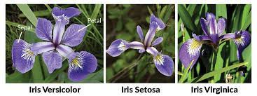
IRIS WEBAPP
Nikhil Sunil Nandoskar

Slide 2
Acknowledgment
I would like to thank Nevi Kaja, Ravi Chellasamy and Team for giving me an opportunity to present my work.

Slide 3
Motivation and Problem Statement
The main motivation behind this project is to get hands on experience on deploying Machine Learning models to Google Cloud Platform.
Problem Statement:
Training Machine Learning models on Iris dataset.
Creating a web service of trained model to predict Iris species.
Testing the web service.
Creating Docker Image.
Deploying the application on Google Cloud Platform.

Slide 4
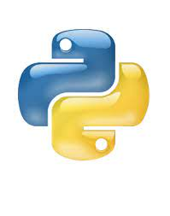
Index
Deployed Model Api
Working Directory Structure
Model Building: a) Exploratory Data Analysis b) Model Training c) Model Results
Creating Flask Api
Testing Flask Api
Docker Image
Deployment on Google Cloud Platform (GCP)
Results
Testing GCP Api
Conclusion
References
Containerize Application
Data Exploration
Model Training
Web Service Framework
Renders index.html
Displays Prediction Output
Test Api

Slide 5
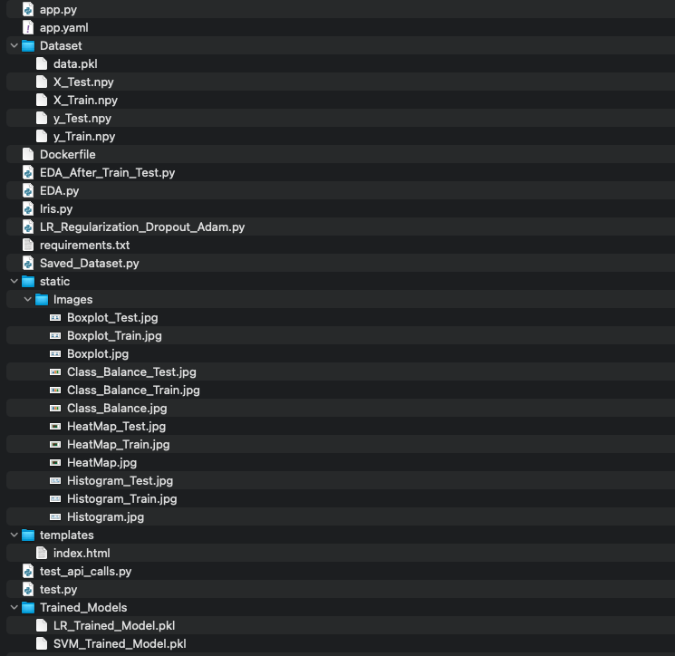
Working Directory Structure

Slide 6
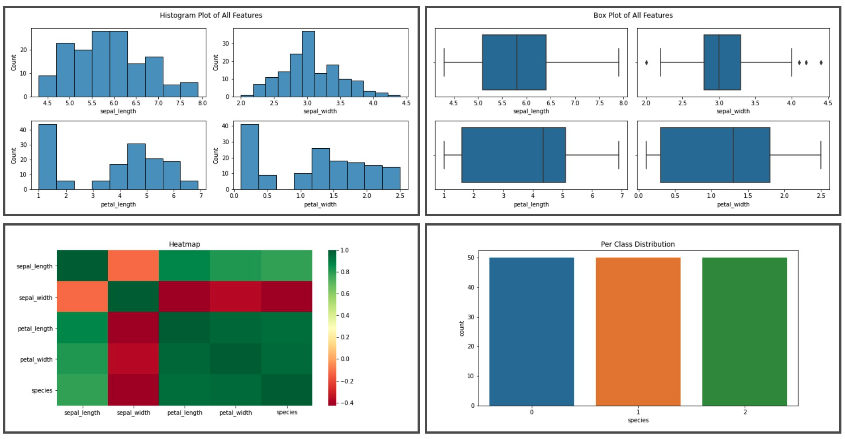
Model Building: a) Exploratory Data Analysis
Total Number of Data Points: 150
Total Number of Features: 4, Feature Names: “Sepal Length”, “Sepal Width”, “Petal Length”, “Petal Width”
Target Column is named “Species” and has three types: “Versicolor”, “Setosa” , “Virginica”
Histogram
Box Plot
Heatmap
Pts/Class

Slide 7
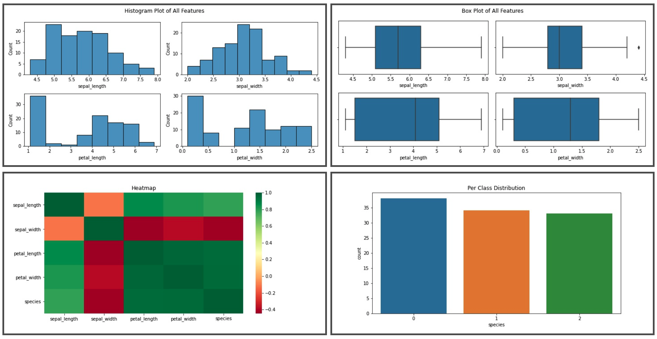
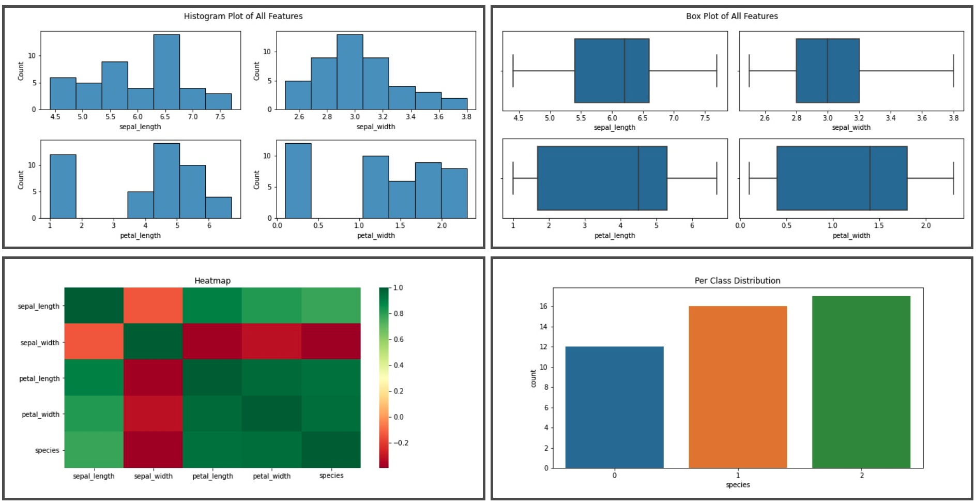
Model Building: a) Exploratory Data Analysis Continued
Used Train Test split from sklearn to obtain 70% Training Data and 30% Testing Data
Total Number of Training Data Points: 105
Total Number of Testing Data Points: 45

Slide 8
Model Building: b) Model Training
1) Logistic Regression: a) 1 hidden layer with 6 neurons built from scratch b) Hyperparameters: Learning Rate = 0.001, Regularization Factor = 0.04, Epochs = 500 Minibatch Size = 10
2) Support Vector Machine Classifier: a) Imported from sklearn b) Hyperparameters: Regularization Factor (C) = 0.6 Kernel = Radial Basis Function (rbf)
http://evomics.org/workshops/advanced-topics/python-logo-glassy/

Slide 9
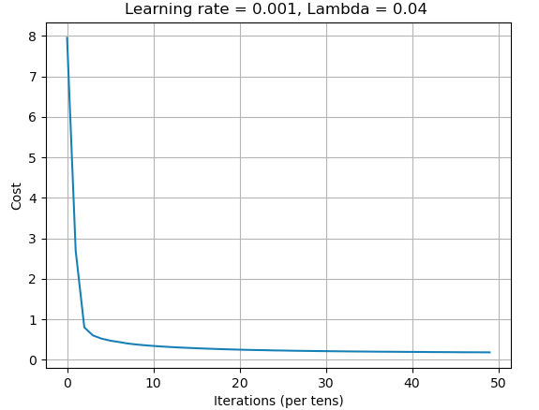
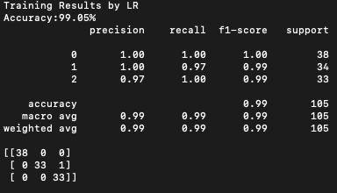
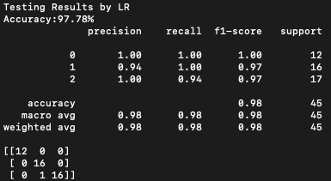
Model Building: b) Model Results
Logistic Regression

Slide 10
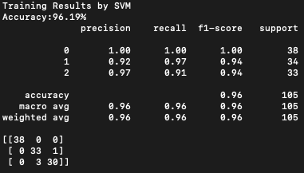
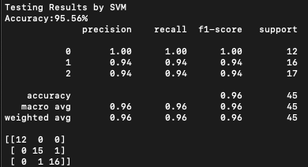
Model Building: b) Model Results Continued
Support Vector Machine Classifier

Slide 11
Creating Flask Api
Flask is one of the web service development framework for Python.
Instance of Flask class is created in the app.py script.
Both the trained models are downloaded once the local port is open.
main() function in the app.py is executed when triggered by method types “Post” and “Get”.
If its a Post request, the script takes in the values for the 4 features and model type and generates prediction output.
It renders the index.html file which is the front page of my application.
The app.py script can be run in terminal by the command “flask run”.
The default port number for flask is 5000.
https://www.google.com/imgres?imgurl=https%3A%2F%2Fcdn.analyticsvidhya.com%2Fwp-content%2Fuploads%2F2020%2F06%2Findex.png&imgrefurl=https%3A%2F%2Fwww.analyticsvidhya.com%2Fblog%2F2020%2F07%2Fdeploy-an-image-classification-model-using-flask%2F&tbnid=GCFqHmll1O7OtM&vet=12ahUKEwj28ZCG1fDyAhUF-KwKHYDiCU8QMygOegUIARDgAQ..i&docid=NCkSR2KlwHCFuM&w=300&h=168&q=flask%20logo%20python&client=safari&ved=2ahUKEwj28ZCG1fDyAhUF-KwKHYDiCU8QMygOegUIARDgAQ

Slide 12
Testing Flask Api
Testing of the Flask api is done using “requests” in Python.
A Get request is sent to app.py through “localhost:5000/test”.
“/test” is triggered in app.py and executes test_api() function.
The response generated is shown in json format as shown below:
I have also explored “pytest” and the output is as follows:

Slide 13
Docker Image
Docker is a tool which lets us put our application into a Container.
It has three main files: 1) Dockerfile: Blueprint for building images. 2) Image: Template for running container. 3) Container: Actual Running process where we have packages related to our application.
Inside docker we pip install all the requirements by reading the requirement.txt file.
The docker image build process is started to the Container Registry in GCP using the following command: gcloud builds submit --tag gcr.io/${GOOGLE CLOUD PROJECT}/${FUNCTION TO EXECUTE} In my case: gcloud builds submit --tag gcr.io/irisapp-325313/main
https://www.google.com/imgres?imgurl=https%3A%2F%2F1000logos.net%2Fwp-content%2Fuploads%2F2017%2F08%2FDocker-logo.jpg&imgrefurl=https%3A%2F%2F1000logos.net%2Fdocker-logo%2F&tbnid=5xBdJUaqLlvTxM&vet=12ahUKEwiqrp7G1fDyAhVOe6wKHS4qDvYQMygDegUIARDRAQ..i&docid=Q1n-u_TTTAkEOM&w=3300&h=2100&q=docker%20logo&client=safari&ved=2ahUKEwiqrp7G1fDyAhVOe6wKHS4qDvYQMygDegUIARDRAQ

Slide 14
Deployment in Google Cloud Platform (GCP)
Create a new project in GCP. A unique Project ID is generated.
Agree to the payment information.
Install Google Cloud SDK to your computer.
Install Cloud Run in GCP.
https://www.google.com/imgres?imgurl=https%3A%2F%2Fcloud.google.com%2F_static%2Fcloud%2Fimages%2Fsocial-icon-google-cloud-1200-630.png&imgrefurl=https%3A%2F%2Fcloud.google.com%2F&tbnid=xIkSNSOOyA48PM&vet=12ahUKEwif4bPt1fDyAhUF0awKHRHuAksQMygCegUIARC1AQ..i&docid=80SWJ_cSDhydbM&w=1200&h=630&itg=1&q=gcp%20logo&client=safari&ved=2ahUKEwif4bPt1fDyAhUF0awKHRHuAksQMygCegUIARC1AQ

Slide 15
Deployment in Google Cloud Platform (GCP) Continued
After building up the Docker Image we can deploy the application using the following command: run deploy --image=gcr.io/${GOOGLE_CLOUD_PROJECT}/${FUNCTION TO EXECUTE} --platform managed In my case: gcloud run deploy --image gcr.io/irisapp-325313/main --platform managed
It then asks for region to select: Enter the number associated to your region.
To verify deployment run the following command: gcloud run services list
Application Api: https://predictiristype-4il23ksazq-uk.a.run.app

Slide 16
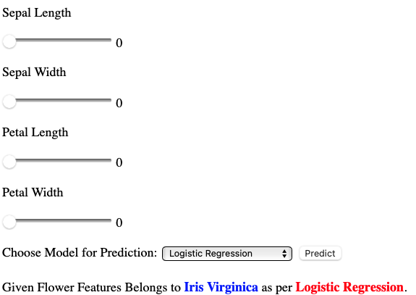
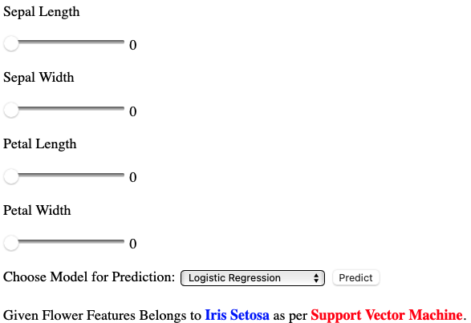
Results

Slide 17
Testing GCP Api
Similar to Testing Flask Api we can Test the GCP Api by querying it.
Replace the localhost port with the GCP Api as follows: https://predictiristype-4il23ksazq-uk.a.run.app/test

Slide 18
Conclusion
Trained Machine Learning Models.
Created a Flask App.
Tested the Flask App.
Created a Docker Image.
Deployed the Image on GCP.
Tested the GCP Api.

Slide 19
References
Ford Logo Image: https://www.google.com/imgres?imgurl=https%3A%2F%2Fupload.wikimedia.org%2Fwikipedia%2Fcommons%2Fthumb%2F3%2F3e%2FFord_logo_flat.svg%2F2560px-Ford_logo_flat.svg.png&imgrefurl=https%3A%2F%2Fcommons.wikimedia.org%2Fwiki%2FFile%3AFord_logo_flat.svg&tbnid=a4IfkSo3p4X4oM&vet=12ahUKEwi74_HU1vDyAhVF0KwKHT5yCssQMygAegUIARDbAQ..i&docid=LCqrtGHbahGNVM&w=2560&h=982&q=ford%20logo&client=safari&ved=2ahUKEwi74_HU1vDyAhVF0KwKHT5yCssQMygAegUIARDbAQ
Iris Dataset Image: https://www.google.com/imgres?imgurl=https%3A%2F%2Fs3.amazonaws.com%2Fassets.datacamp.com%2Fblog_assets%2FMachine%2BLearning%2BR%2Firis-machinelearning.png&imgrefurl=http%3A%2F%2Fwww.lac.inpe.br%2F~rafael.santos%2FDocs%2FCAP394%2FWholeStory-Iris.html&tbnid=P-PGjABuYKeYpM&vet=12ahUKEwiF87P01vDyAhVCTqwKHdEJAWwQMygBegUIARDFAQ..i&docid=DWcNzEt0Tz4F4M&w=1275&h=477&q=iris%20dataset&client=safari&ved=2ahUKEwiF87P01vDyAhVCTqwKHdEJAWwQMygBegUIARDFAQ
Python Requests Library: https://docs.python-requests.org/en/master/user/quickstart/
Google SDK Download: https://cloud.google.com/sdk/docs/install
Docker File: https://cloud.google.com/run/docs/quickstarts/build-and-deploy/python
Docker Deployment: https://codelabs.developers.google.com/codelabs/cloud-run-deploy#0

Slide 20
THANK YOU

